Slide 1

SemanticSeg_Pytorch_Master
&
DeepGlobe Challenge:Statistic&Tricks
Speaker:Guo Haonan
Major：RS&GIS
Tutor：Prof.Shi
地理科学与规划学院
2019.08.31

Slide 2
1 Learning Progress
2 SemanticSeg_Pytorch_Master
3 DeepGlobe Conclusion & Tricks
4 Reference& Recommend Materials

Slide 3
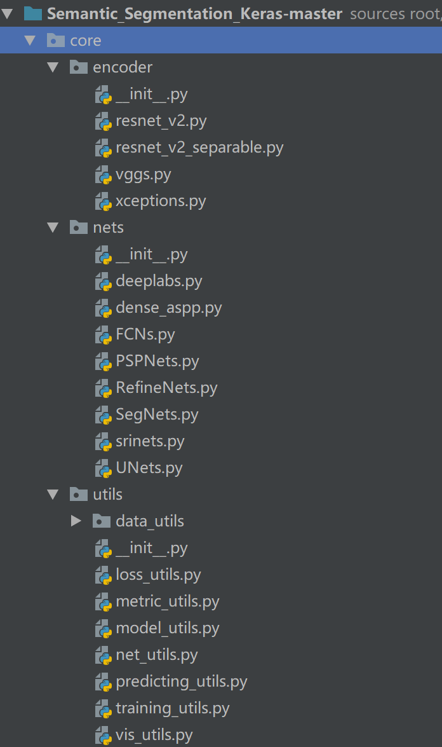
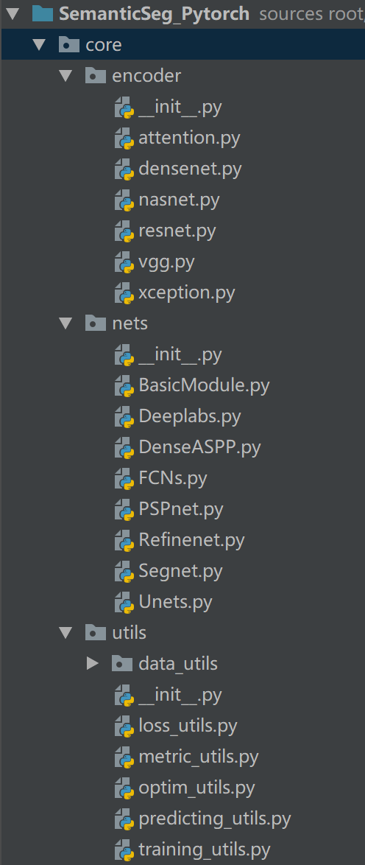
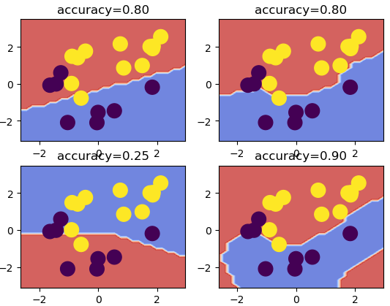
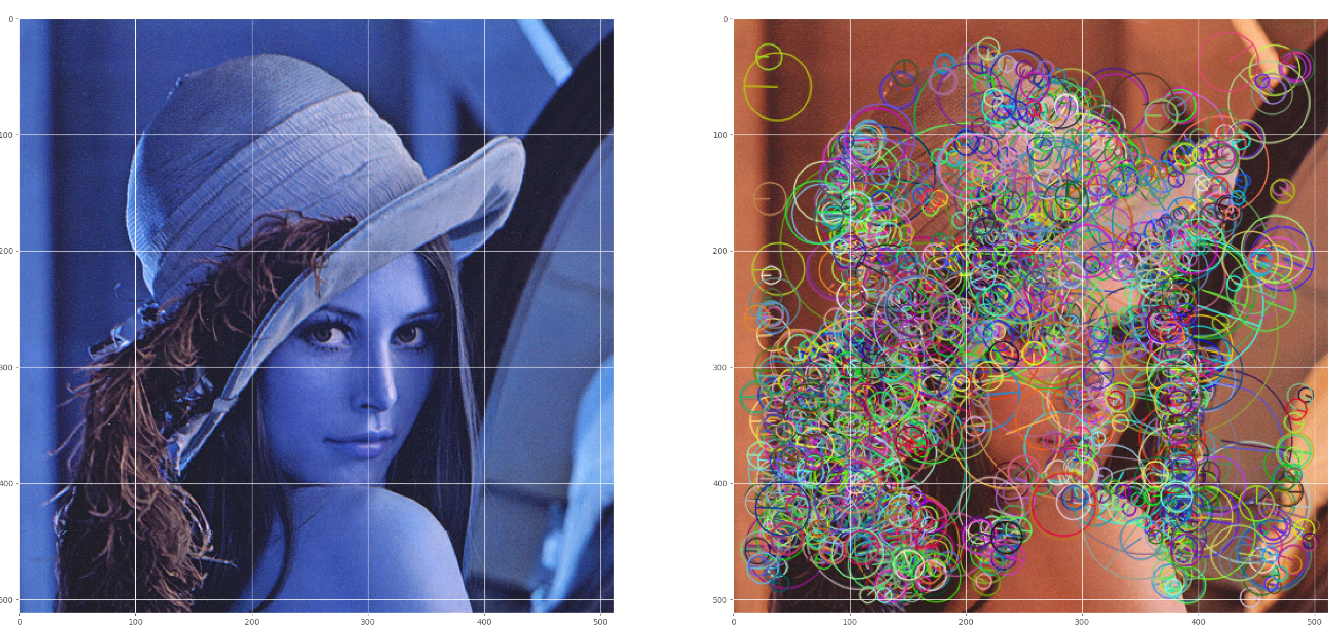
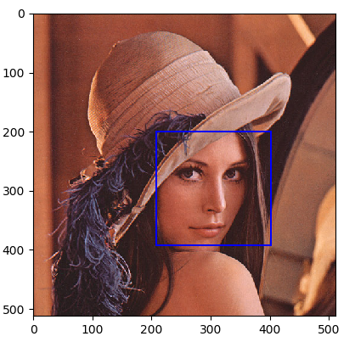
Learning Progress
Deep Learning
SemanticSeg_Pytorch_Master 大礼包 Pytorch版(More Encoder +Loss +Better Augmentation)
DeepGlobe CVPR2018 Overview & tricks
CV+ML
Keras
OpenCV for Python
Traditional ML method for Computer Vision
Torch
BGR Harris
Adaboost Detector
SVM Kernels`

Slide 4
1 Learning Progress
2 SemanticSeg_Pytorch_Master
3 DeepGlobe Conclusion & Tricks
4 Reference& Recommend Materials

Slide 5


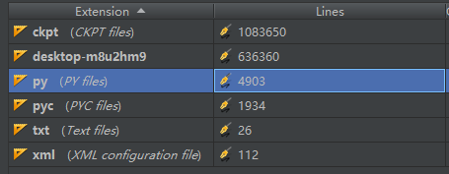

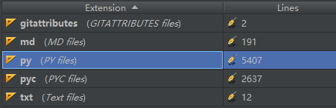
Pytorch大礼包
SemanticSeg_Pytorch_Master
相比于Keras/TF不同：
Pytorch 介于Keras（高级API，层定义为函数）与TF（底层，声明式编程多）之间
Tensor Numpy互相转换，过程可控，可视化容易（动态图）
训练验证以循环完成+模型以类定义（_forward_ vs compile）
自定义损失函数/设置分层学习率等较为方便
CE无需One hot
缺点：
定义对象时需确定输入层数（Keras不用）
GPU训练需手动.cuda()
网络结构逻辑更清晰但阅读较Keras困难
社区没有TF/Keras成熟

Slide 6
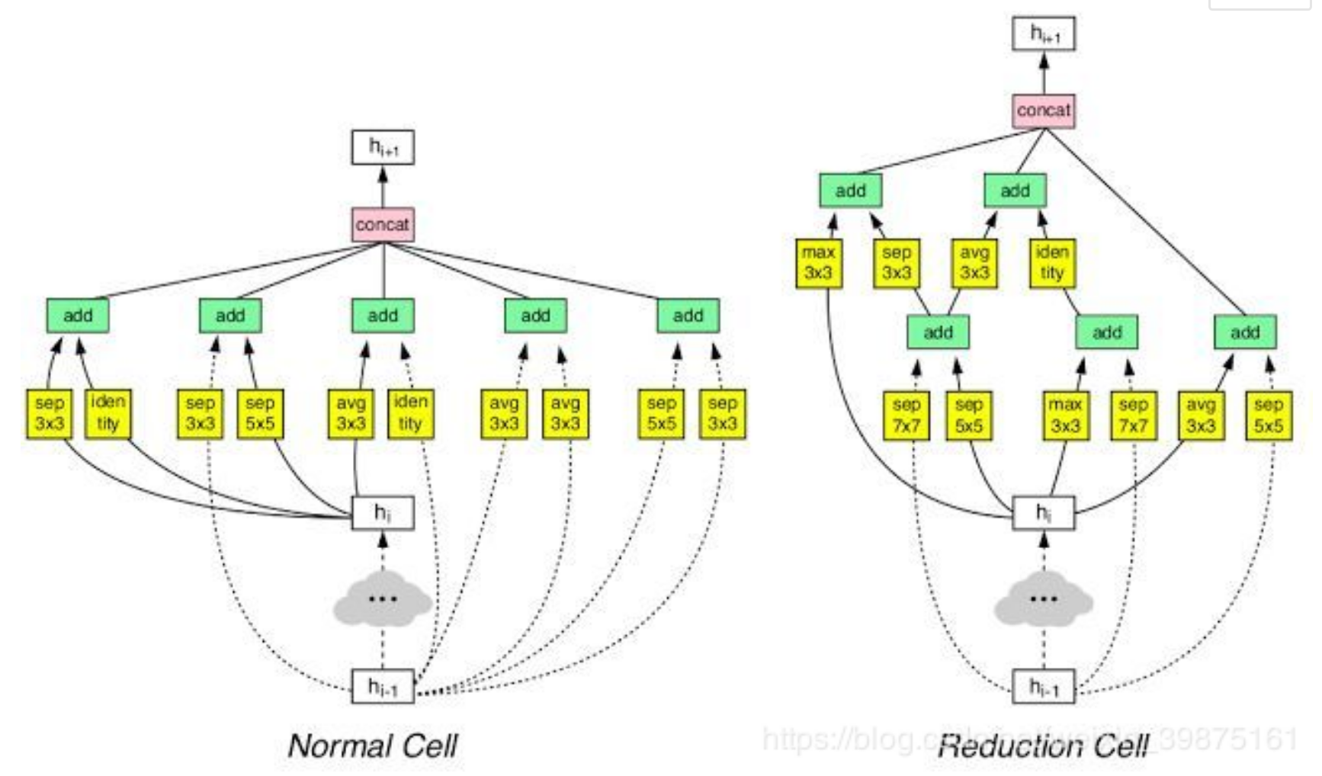
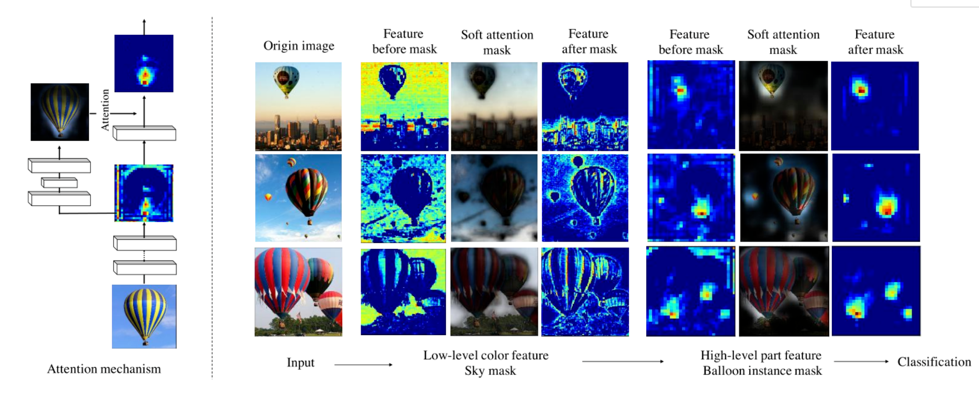
Pytorch大礼包
SemanticSeg_Pytorch_Master
scope_table = { "resnet_18": {"pool1":64, "pool2": 64, "pool3": 256, "pool4": 512,"out4":2048}, "resnet_50": {"pool1":64, "pool2": 64, "pool3": 256, "pool4": 512,"out4":2048}, "resnet_101": {"pool1":64, "pool2": 64, "pool3": 256, "pool4": 512,"out4":2048}, "resnet_152": {"pool1":64, "pool2": 64, "pool3": 256, "pool4": 512,"out4":2048}, "resnext50_32x4d": {"pool1":64, "pool2": 64, "pool3": 256, "pool4": 512,"out4":2048}, "resnext101_32x8d": {"pool1":64, "pool2": 64, "pool3": 256, "pool4": 512,"out4":2048}, "nasnet": {"pool0":44,"pool1": 352, "pool2": 1056, "out2": 1056}, "densenet_121": {"pool0":64,"pool1": 128, "pool2": 256, "pool3": 512, "out3": 1024}, 'vgg11': {"pool0":64,"pool1": 128, "pool2": 256, "pool3": 512,"out4":512}, 'vgg13': {"pool0":64,"pool1": 128, "pool2": 256, "pool3": 512, "pool4": 512,"out4":512}, 'vgg16': {"pool0":64,"pool1": 128, "pool2": 256, "pool3": 512, "pool4": 512,"out4":512}, 'vgg19': {"pool0":64,"pool1": 128, "pool2": 256, "pool3": 512, "pool4": 512,"out4":512}, 'vgg11_bn': {"pool0":64,"pool1": 128, "pool2": 256, "pool3": 512, "pool4": 512,"out4":512}, 'vgg13_bn': {"pool0":64,"pool1": 128, "pool2": 256, "pool3": 512, "pool4": 512,"out4":512}, 'vgg16_bn': {"pool0":64,"pool1": 128, "pool2": 256, "pool3": 512, "pool4": 512,"out4":512}, 'vgg19_bn': {"pool0":64,"pool1": 128, "pool2": 256, "pool3": 512, "pool4": 512,"out4":512}, 'xception_41': {"pool1": 128, "pool2": 256, "pool3": 728, "pool4": 2048,"out4":2048}, 'attention_56': {"pool0":64,"pool1": 256, "pool2": 512, "pool3": 1024, "pool4": 2048,"out4":2048}, 'attention_92': {"pool0":64,"pool1": 256, "pool2": 512, "pool3": 1024, "pool4": 2048,"out4":2048}
Resnet V2
SepConv Resnet
Nasnet AutoML
Densenet
VGG
Xception
Attention
assert name in [
'Deeplab_v3p','Deeplab_v3’,
'DenseASPP’,
'FCN8s','FCN16s','FCN32s’,
'PSPNet', 'RefineNet','RefineNetPoolingImproved’,
'UNet','ResUNet’
]
Deeplab
DenseASPP
FCN
PSP
Refine
Unet

Slide 7
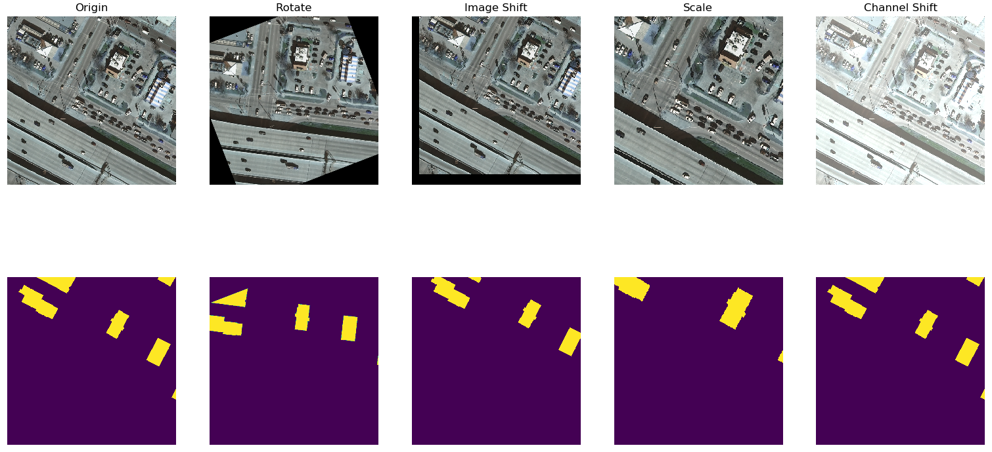
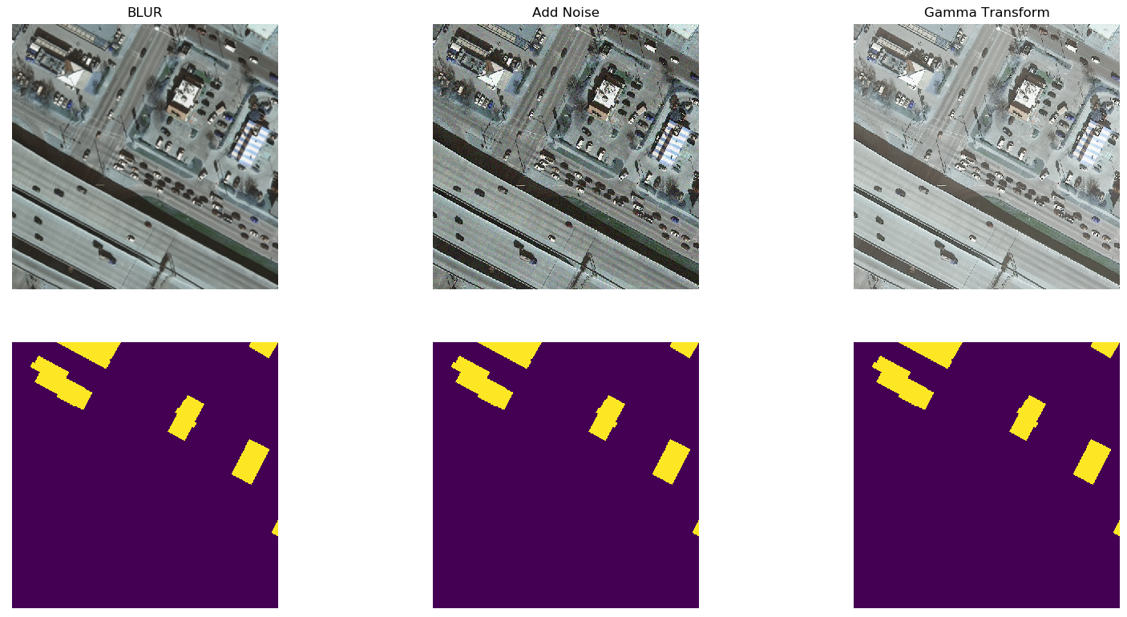
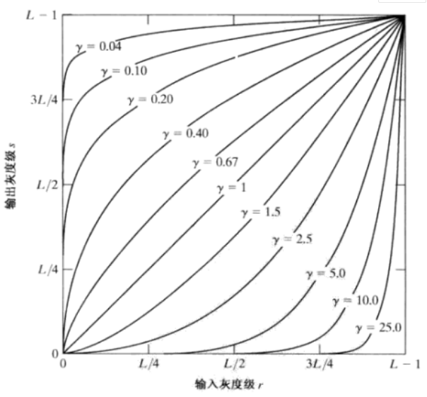
Pytorch大礼包
Data Augmentation
Rotate
Shift
Scale
Channel Shift
Blur
Add Noise
Gamma Transform
Random Stretch
Vertical Flip
Horizontal Flip
1.围绕var正态分布
2.随机[255,255,255]

Slide 8
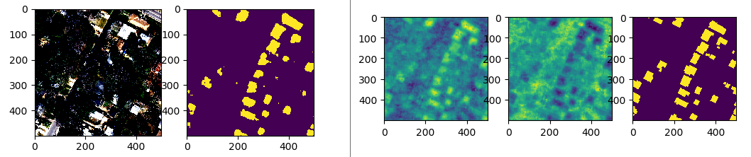
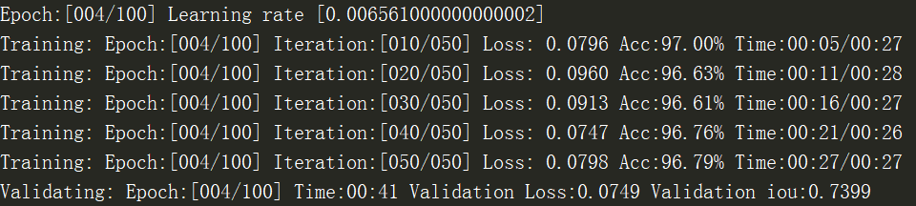
Pytorch大礼包
Training&Validating
in ['stepwise','exp','cos','plateau','None']
简单训练过程可视化
['L1Loss','SmoothL1Loss','MSELoss','BCELoss','BCEWithLogitsLoss','CrossEntropyLoss','KLDivLoss’,’FocalLoss’,’SoftDiceLoss’,’IOU’,’ lovasz_softmax’,’MyLoss’,’ OHEMFocalLoss’]
Self Defined Metric in Validating

Slide 9
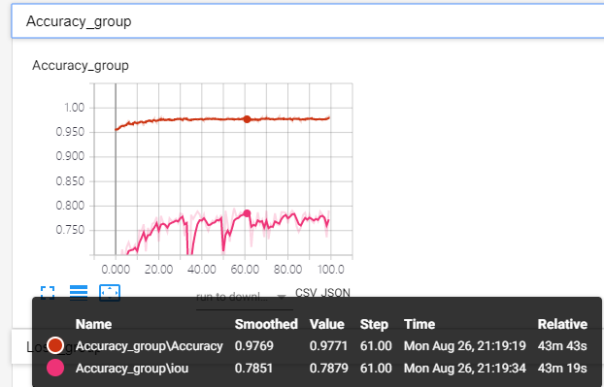
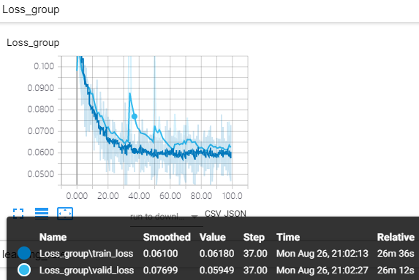
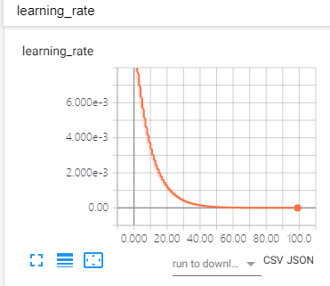
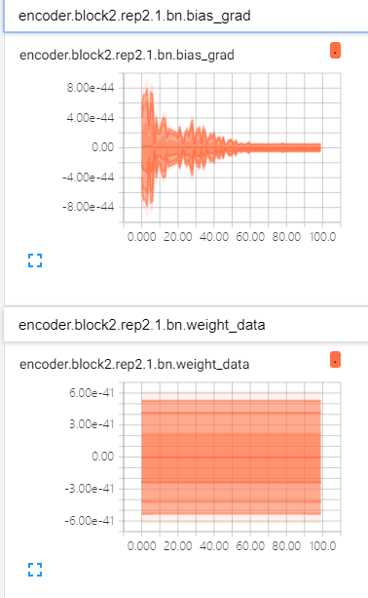
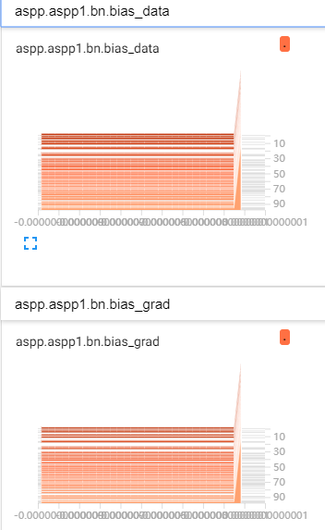
Pytorch大礼包
TensorboardX
Train/Val Accuracy
Train/Val Loss
Learning Rate
Weight
&
Grad
Histogram
Weight
&
Grad

Slide 10
1 Learning Progress
2 SemanticSeg_Pytorch_Master
3 DeepGlobe Conclusion & Tricks
4 Reference& Recommend Materials

Slide 11
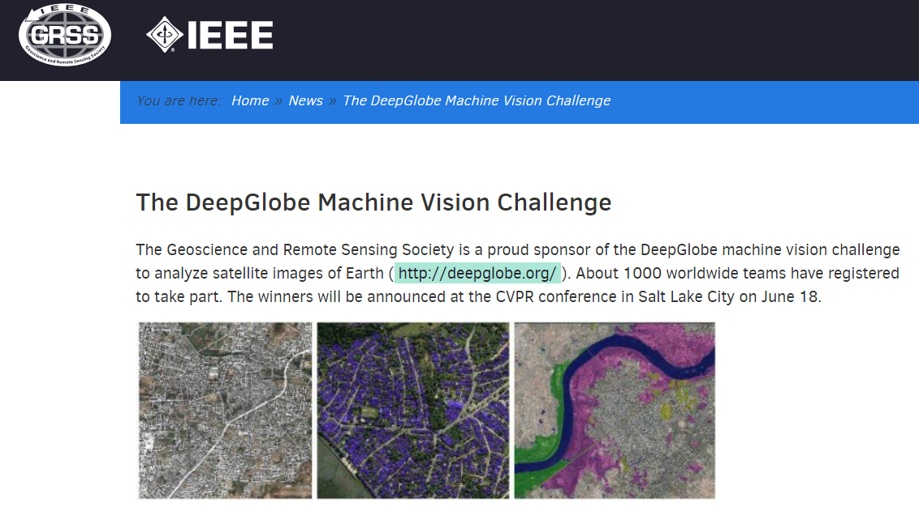
Deep Globe Challenge
Introduction
Building Extraction Challenge*7 √
Landuse Classification Challenge*8
Road Extraction Challenge*8 √
Validation Area

Slide 12
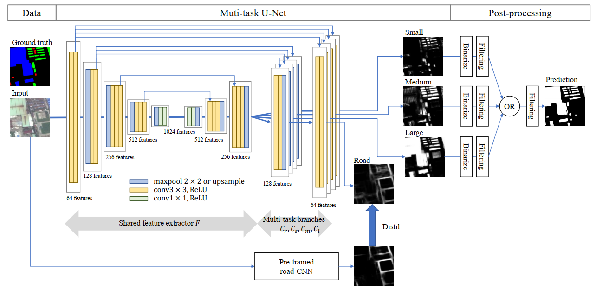
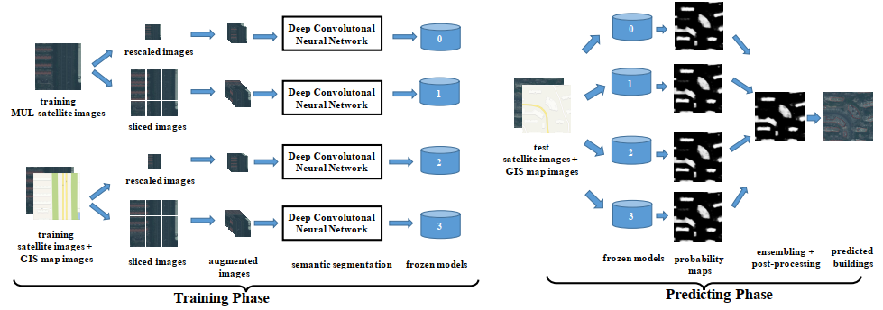
Deep Globe Challenge
Building Footprint Detection Summary
Deeplab’s performance comes from the ability to tiny objects and big ones, not so useful in BFD. ——CNNs Fusion….
Evaluation accuracies of Deeplabv3+ are much lower than U-Net.
——Multi-source GIS MAP
Validation Area

Slide 13
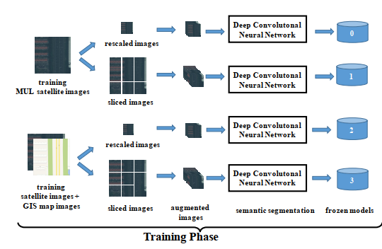
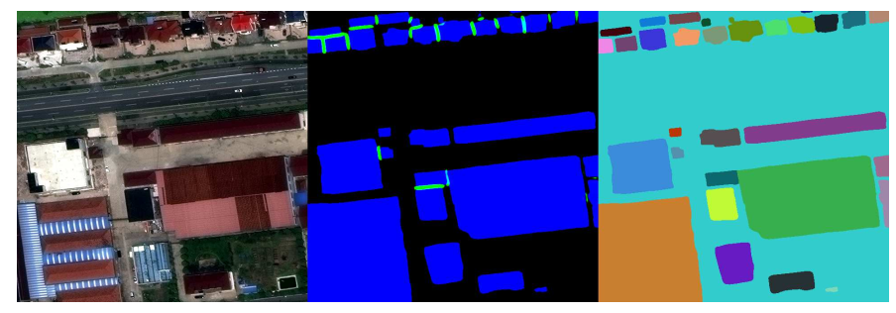
Deep Globe Challenge
Some Impressive Tricks
1.CNN Fusion
MUL
RGB
MUL+OSM
5.Multi Class Size of buildings
Different size of input
3 Result+MUL+Unet=Fused Result
2.Loss
BCE+IOU
Lovasz_softmax(torch_master included)
3.Classes
Building+BG+Touching Borders
Road Improve a lot!
4.Structure
INPLACE-ABN(50%s storage saved!)
WideResne(x)t

Slide 14
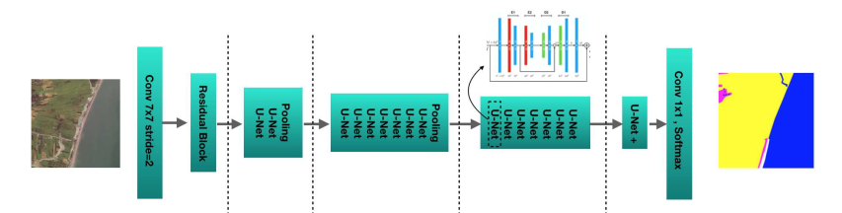
Deep Globe Challenge
Land Use Classification —— Impressive Tricks
1.Super-Pixel+GCN
面向对象分割+图卷积
SCNN
2.Soft Semantic Labels
Gaussian Filter on each class
To solve boundary uncertainty
5.Other Trick Different Scale Size——Match Best Inception Field
Haralick features(GLCM)
Deeper&Stacked Unet
Adding Road Extracting Task
2.Loss
IOU（Widely used）
Lovasz_softmax
3.Optimizer
SWA instead of SGD
4.Structure
ELU Activation

Slide 15
1 Learning Progress
2 SemanticSeg_Pytorch_Master
3 DeepGlobe Conclusion & Tricks
4 Reference& Recommend Materials

Slide 16
Reference
Reference
《机器学习——使用OpenCV和Python进行智能图像处理》Micheal Beyeler
《机器学习算法视角》——Stephen Marsland
《Effective Python_59 Specific Ways to write better python》——Breet Slakin
《 Python机器学习算法》——赵志勇
《Pytorch模型训练实用教程》——余霆篙
DeepGlobe
[1]D-LinkNet: LinkNet with Pretrained Encoder and Dilated Convolution for High Resolution Satellite Imagery Road Extraction. 2018.192-1924. 10.1109/CVPRW.2018.00034.
[2]Building Detection From Satellite Imagery Using Ensemble of Size-Specific Detectors
Ryuhei Hamaguchi, Shuhei Hikosaka. 2018.192-1924. 10.1109/CVPRW.2018.00034.
[3]Dense Fusion Classmate Network for Land Cover Classification.Chao Tian, Cong Li, Jianping Shi. 2018.192-1924. 10.1109/CVPRW.2018.00034.
[4]Semantic Binary Segmentation Using Convolutional Networks Without Decoders.Shubhra Aich, William van der Kamp, Ian Stavness. 2018.192-1924. 10.1109/CVPRW.2018.00034.
[5]Rotated Rectangles for Symbolized Building Footprint ExtractionMatt Dickenson, Lionel Gueguen. 2018.192-1924. 10.1109/CVPRW.2018.00034.
[6]Building Detection From Satellite Imagery Using a Composite Loss Function,Sergey Golovanov. 2018.192-1924. 10.1109/CVPRW.2018.00034.
[7]TernausNetV2: Fully Convolutional Network for Instance Segmentation,Vladimir Iglovikov,
Semantic Segmentation Based Building Extraction Method Using Multi-Source GIS Map Datasets and Satellite Imagery,Weijia Li, . 2018.192-1924. 10.1109/CVPRW.2018.00034.
[8]CNNs Fusion for Building Detection in Aerial Images for the Building Detection Challenge,Remi Delassus. 2018.192-1924. 10.1109/CVPRW.2018.00034.
[9]Building Extraction From Satellite Images Using Mask R-CNN With Building Boundary Regularization,Kang Zhao. 2018.192-1924. 10.1109/CVPRW.2018.00034.
[10]Deep Aggregation Net for Land Cover Classification,Tzu-Sheng Kuo, . 2018.192-1924. 10.1109/CVPRW.2018.00034.
[11]Feature Pyramid Network for Multi-Class Land SegmentationSelim Seferbekov, Vladimir Iglovikov, Alexander Buslaev, Alexey Shvets. 2018.192-1924. 10.1109/CVPRW.2018.00034.
[12]Uncertainty Gated Network for Land Cover Segmentation,Guillem Pascual, Santi Segui, Jordi Vitria. 2018.192-1924. 10.1109/CVPRW.2018.00034.
[13]Land Cover Classification With Superpixels and Jaccard Index Post-Optimization,Alex Davydow, Sergey Nikolenko . 2018.192-1924. 10.1109/CVPRW.2018.00034.

Slide 17

Thank you!
Speaker:Guo Haonan 16306010
Major：RS&GIS
Tutor：Prof.Shi
地理科学与规划学院
2019.08.31

